Slide 1
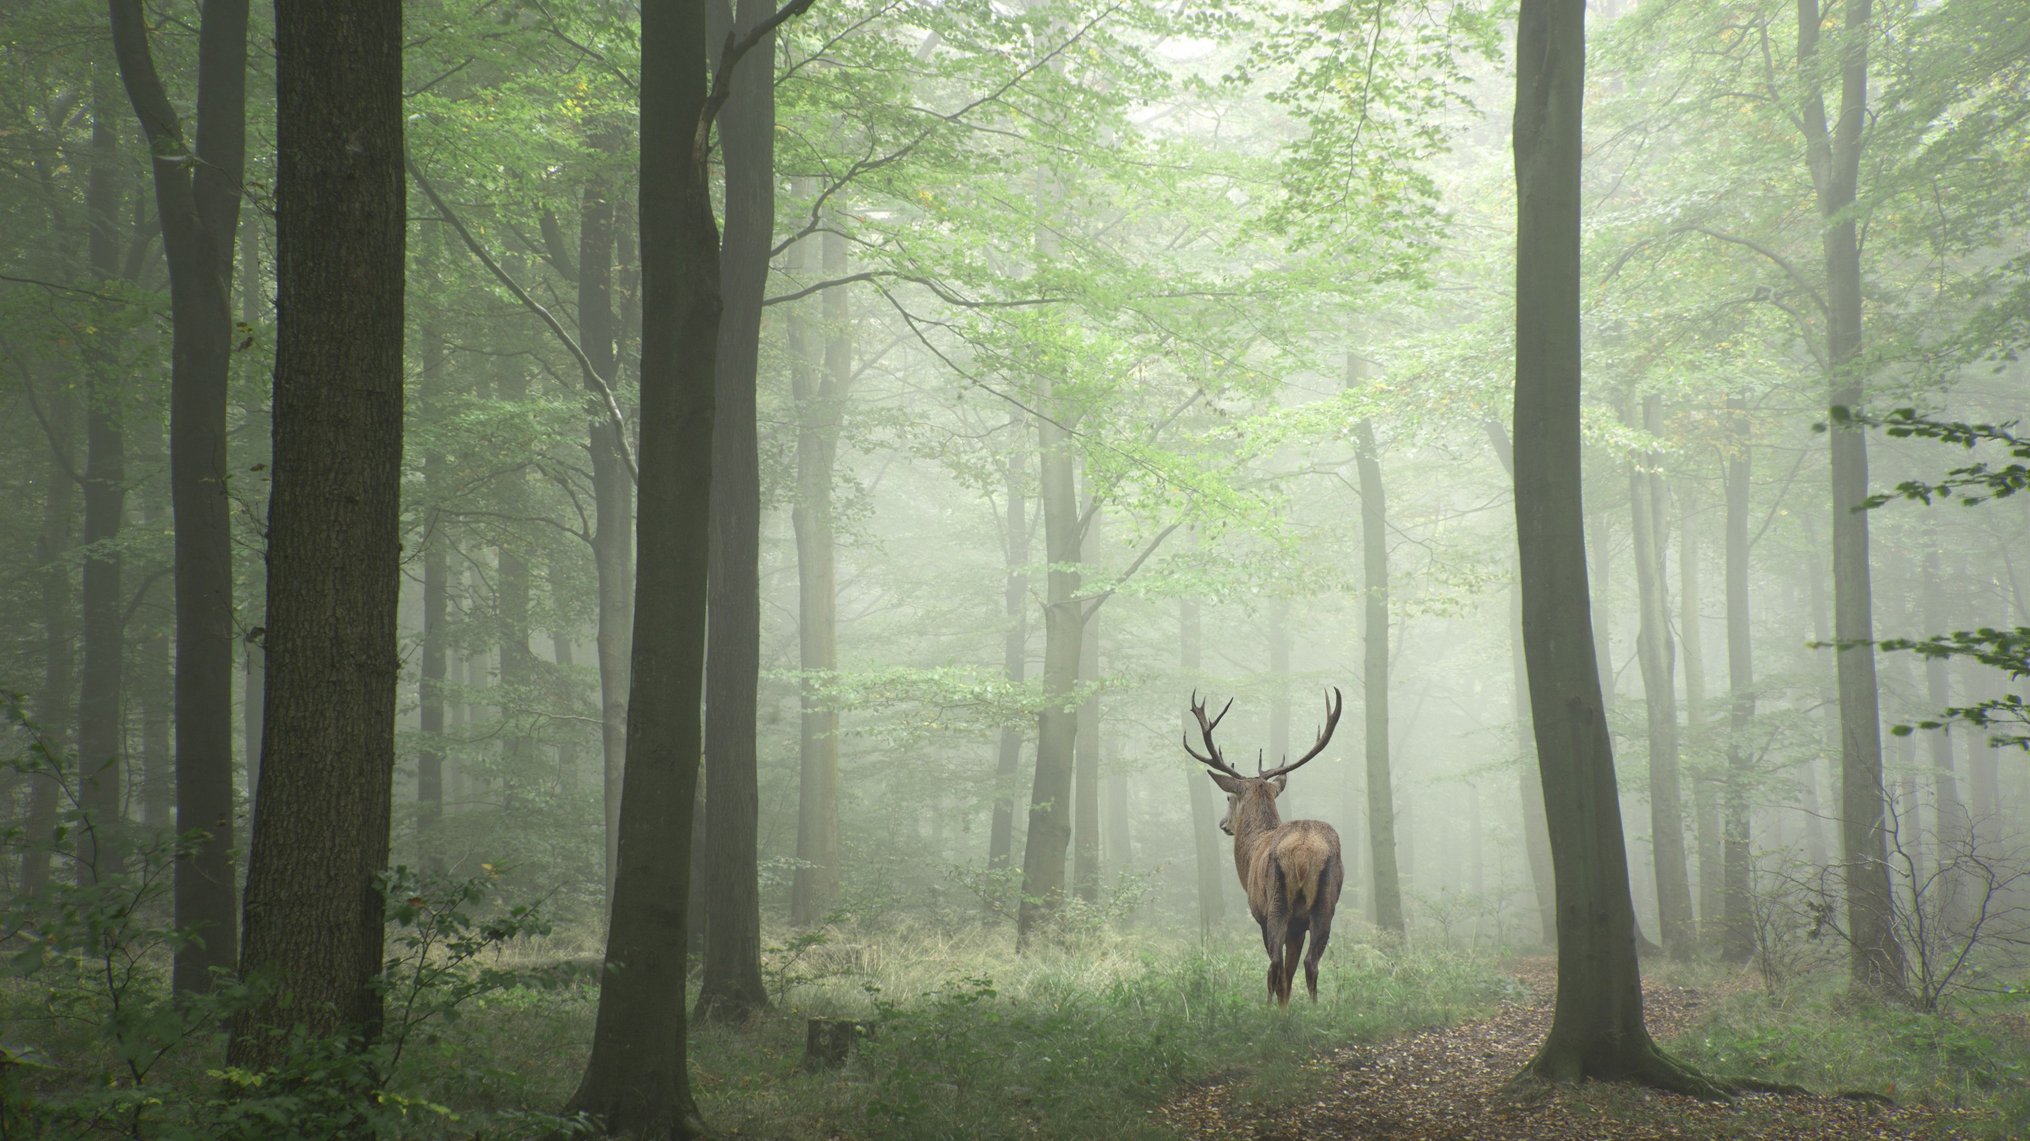
PLAY
OPTIONS
QUIT

Slide 2
START GAME
SETTINGS
QUIT

Slide 3




CONTINUE
OPTIONS
LEAVE GAME

Slide 4
CONTINUE
OPTIONS
LEAVE GAME

Slide 5

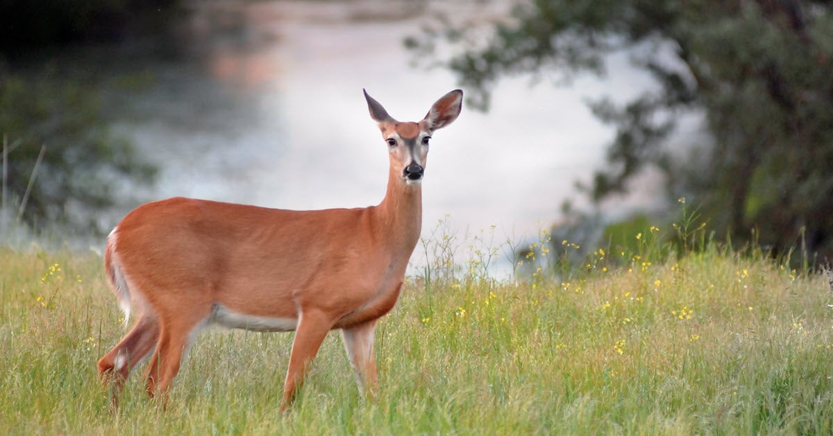
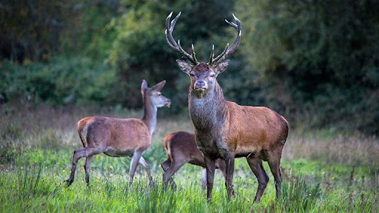



They are members of the Bovidae, which are also known as permanently horned antelopes. They are not related to the ruminant family Ruminantia. The common ancestor of these animals is the chevrotain, which is also known as the musk deer. They have played a significant role in art, literature, and religion.
WILDLIFE NOTEBOOK
Deer
Educational Video
Start Quiz
Deer are members of the Cervidae family. There are two main groups of deer, the Cervinae and the Capreolinae. They are both hoofed ruminant mammals. They are members of the Bovidae, which are also known as permanently horned antelopes. They are not related to the ruminant family Ruminantia. The common ancestor of these animals is the chevrotain, which is also known as the musk deer. They have played a significant role in art, literature, and religion.
ADD ANIMAL

Slide 6
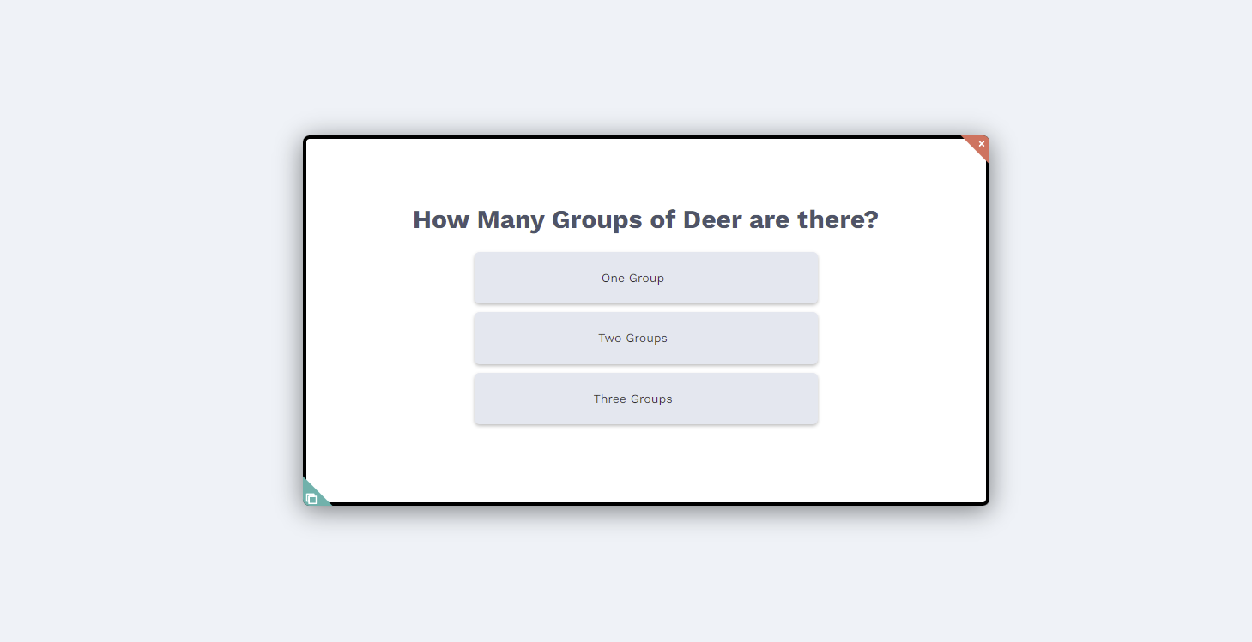
QUIZ

Slide 7
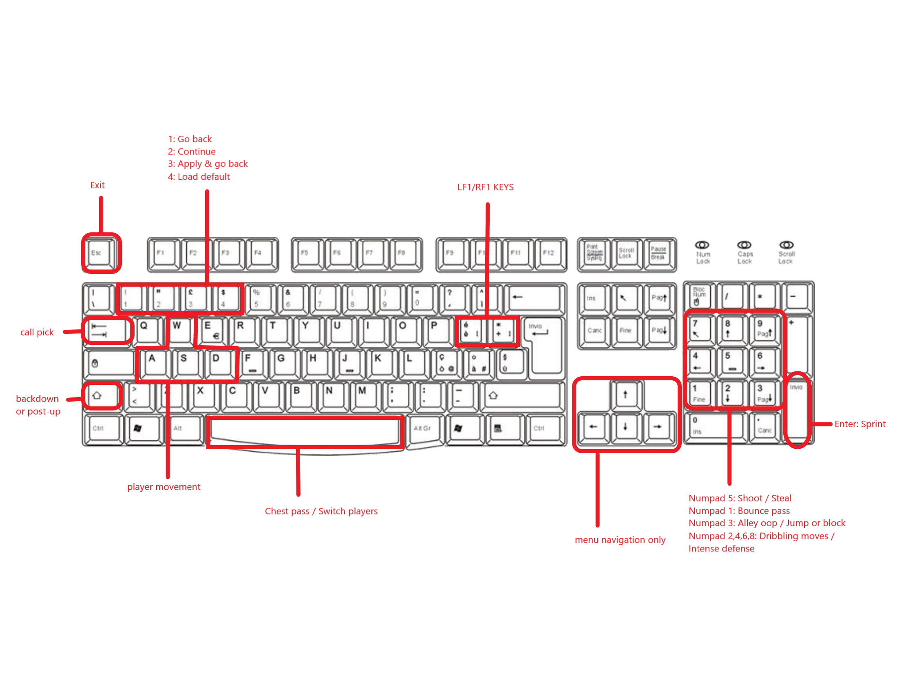
CONTROLS

Slide 8
SETTINGS
VOLUME
CONTROLS

Slide 9

LOADING…

Slide 10


VOLUME

Slide 11


E

Slide 13
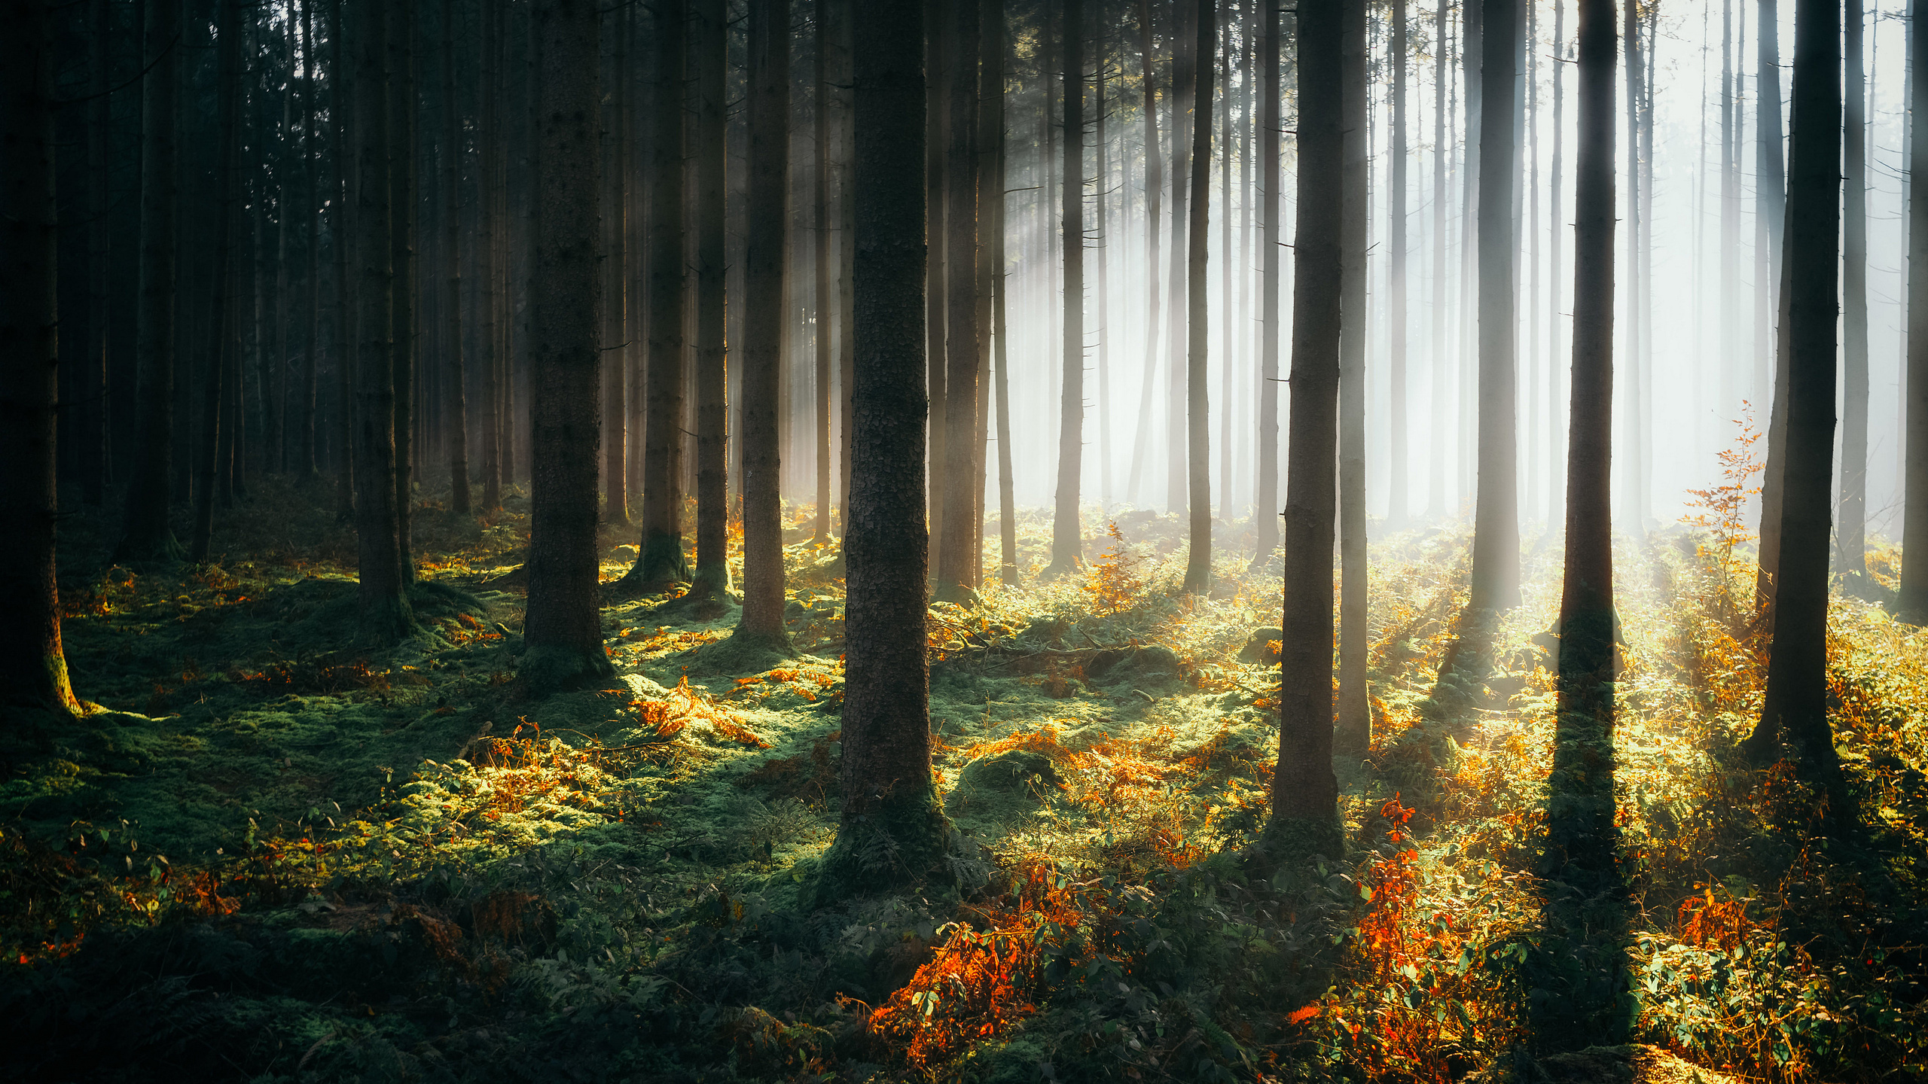
LOADING GAME: 74%

Slide 14
LOADING ENVIRONMENTS: 85%

Slide 15
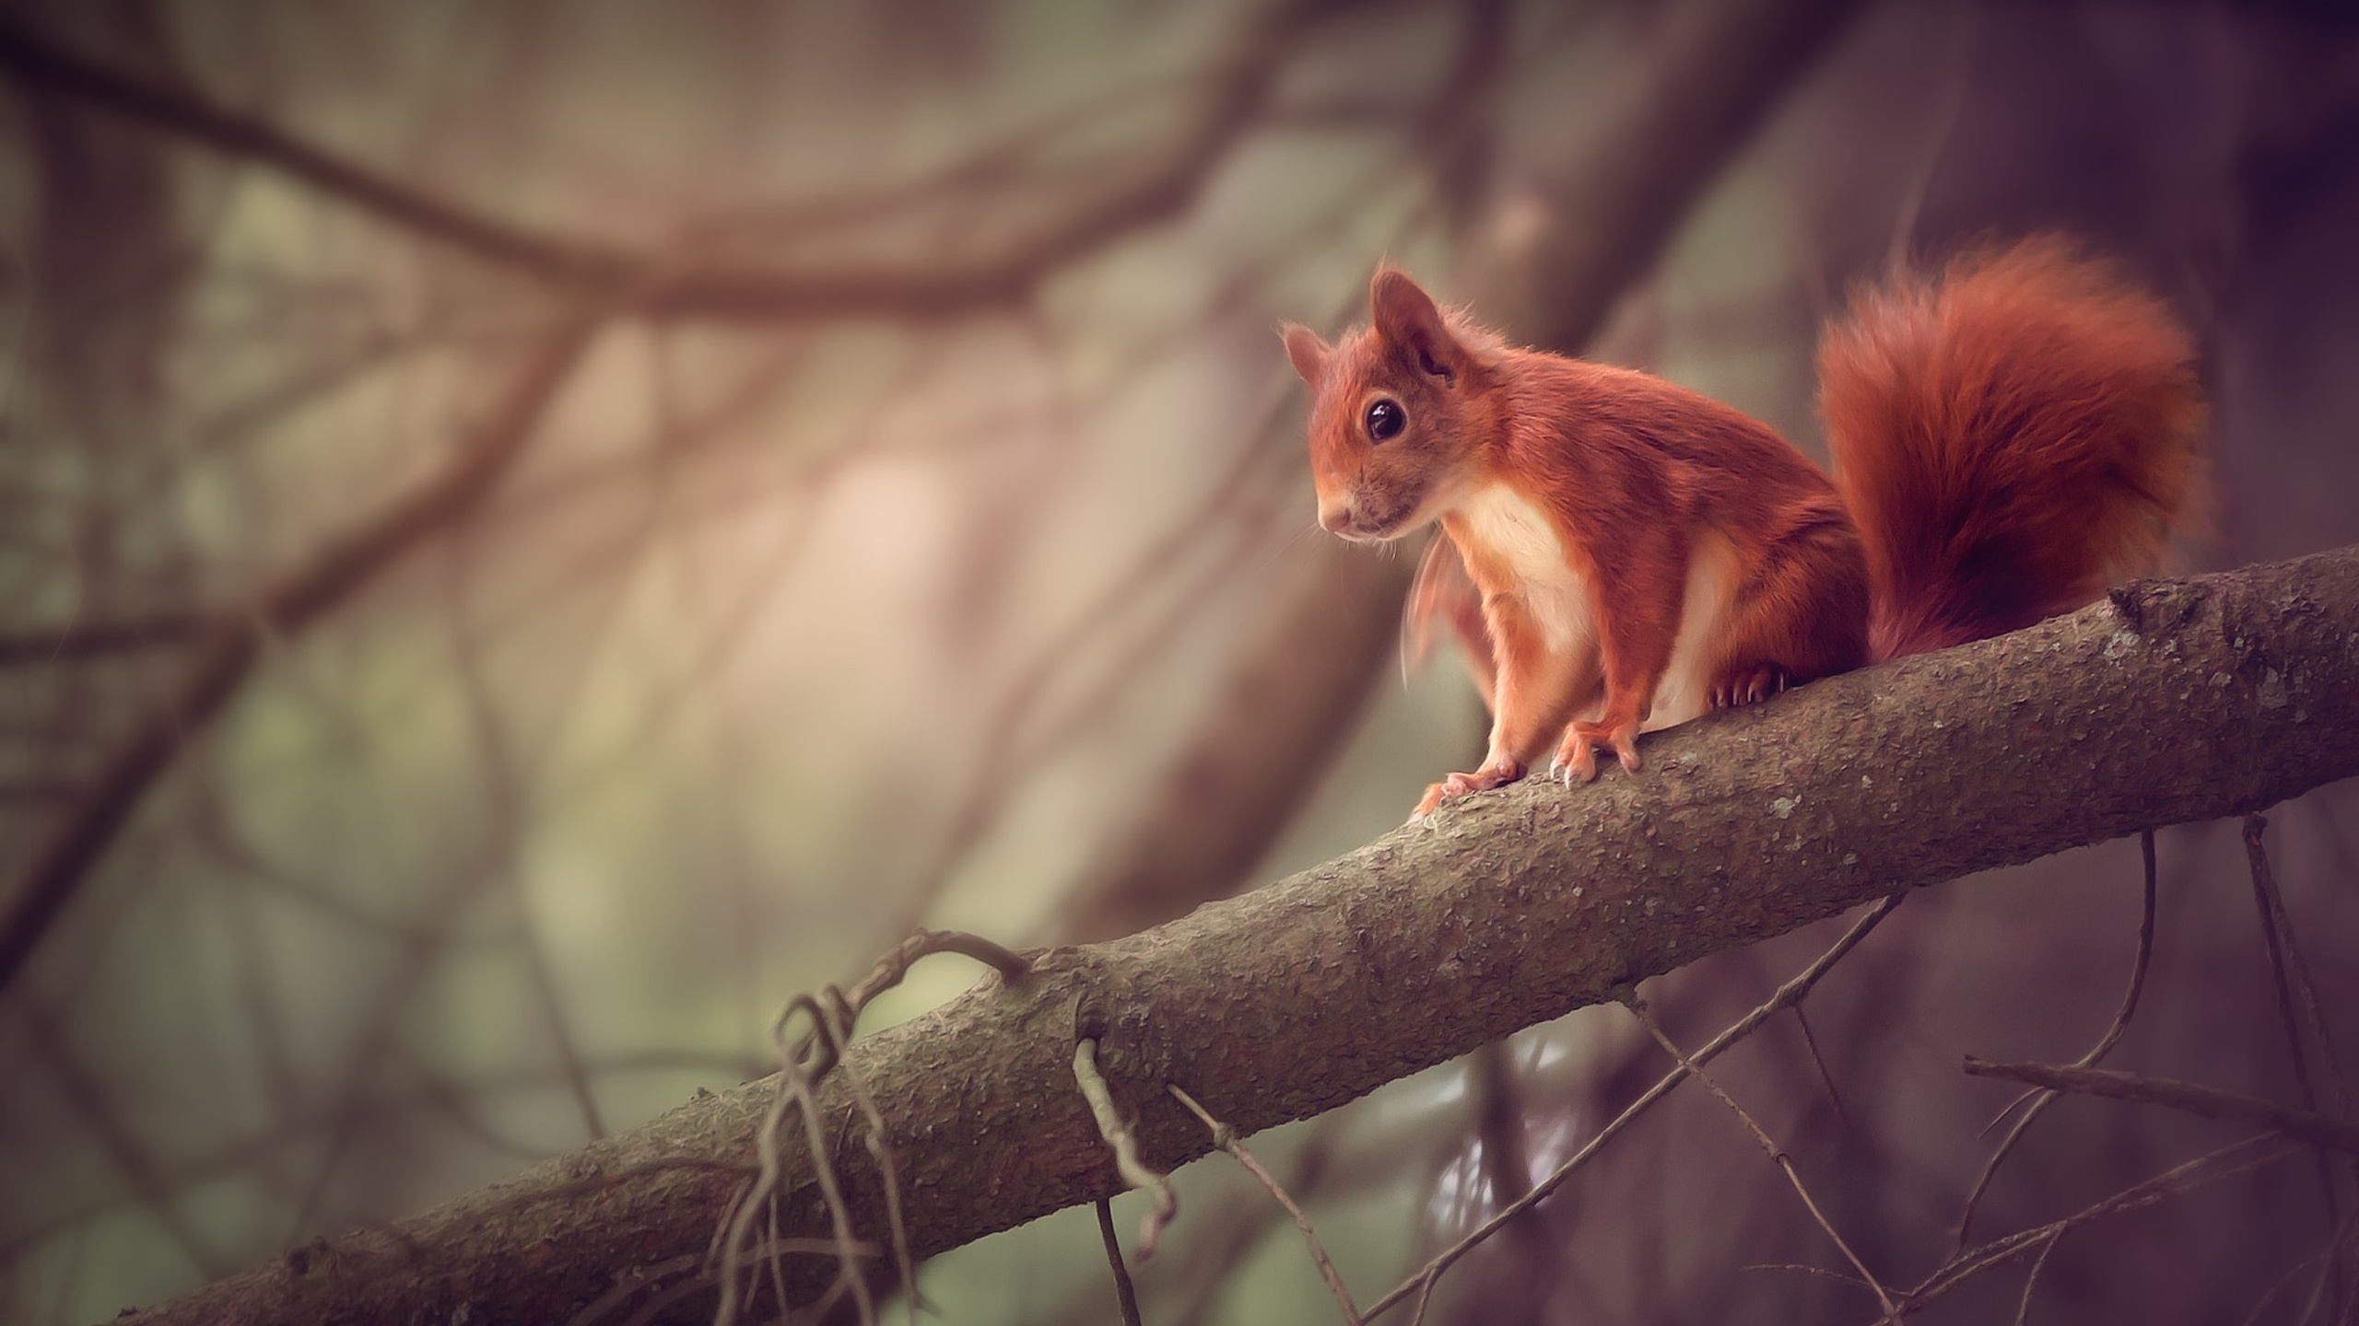
WILD-IRELAND
PLAY
OPTIONS
LEAVE GAME

Slide 16

BACK
OPTIONS
VOLUME
CONTROLS
Move Forward
Select
W
E
Inspect
A
S
D
Move Left
Move Right
Move Back

Slide 17
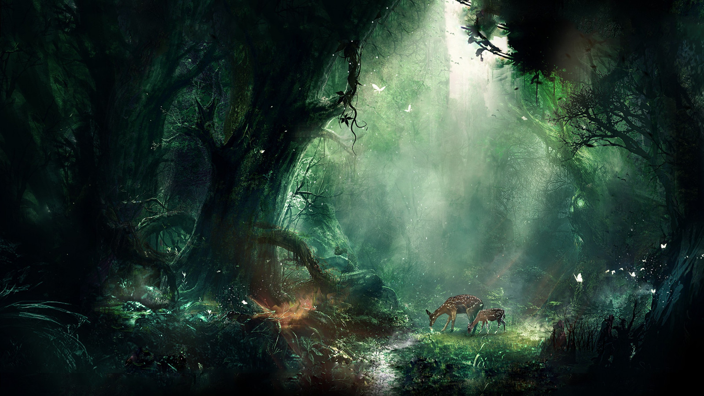



ESC
1

Slide 18


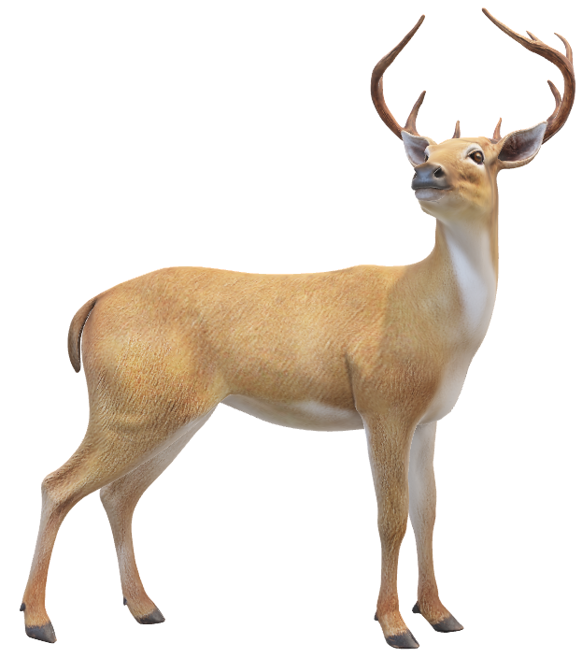
ADD TO INVENTORY
EXIT

Slide 19

ADD TO INVENTORY
EXIT

Slide 20
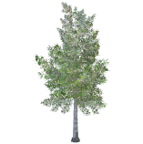


EXIT

Slide 21



BACK
The Red Deer
START QUIZ
Deer are members of the Cervidae family. There are two main groups of deer, the Cervinae and the Capreolinae. They are both hoofed ruminant mammals. They are members of the Bovidae, which are also known as permanently horned antelopes. They are not related to the ruminant family Ruminantia. The common ancestor of these animals is the chevrotain, which is also known as the musk deer. They have played a significant role in art, literature, and religion.

Slide 22
EXIT
What family is the Red Deer a member of?
Cervidae Family
Leporidae Family
Canidae Family
NEXT

Slide 23
EXIT
FINAL SCORE
5/8
PLAY AGAIN?

Slide 24
PAUSE MENU
RESUME
OPTIONS
SAVE GAME
RETURN TO MAIN MENU

Slide 25
BACK
OPTIONS
VOLUME
CONTROLS
Move Forward
Select
W
E
Inspect
A
S
D
Move Left
Move Right
Move Back

Slide 26
BACK
Save Game As..
My_Game|
SAVE

Slide 27
BACK
Choose A Game To Load
My_Game.save

Slide 28


Application run on Computer
Presentation Layer
UNITY
Middle Tier
BLENDER
Easy-Save Database
Data Tier

Slide 29

General usage
Controls
VOLUME
Accessing game
Using Start Menu
SETTINGS
QUIT
User
Exploring Terrain
Generation
Inspecting
PAUSE MENU
Inventory
Using Inventory
Adding Wildlife
Using Quiz
Using save System

Slide 30
What is it?
What methods have I researched?
Advantages and disadvantages?
What method am I using?/Decision

Slide 31
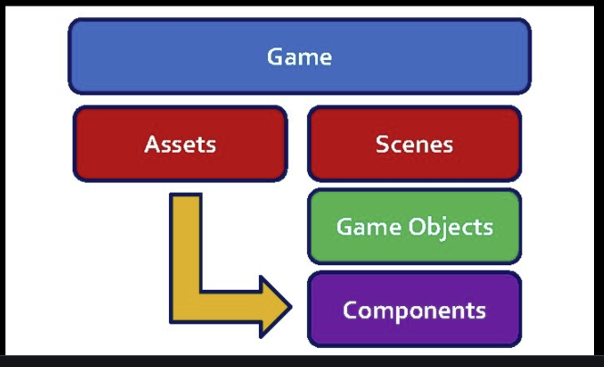
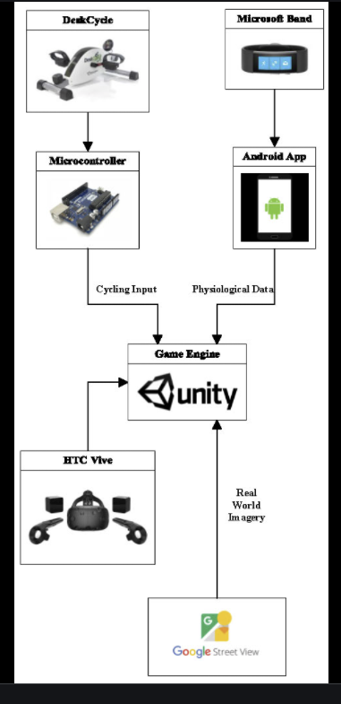

Slide 32




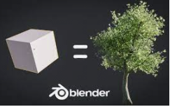





User
Blender
Game
Models
Users Computer
Unity Engine
Scripts (C#)
Assets
Prefabs
Materials
Classes
User Interface
Scenes
Script Editor
Game Objects
Components

Slide 33
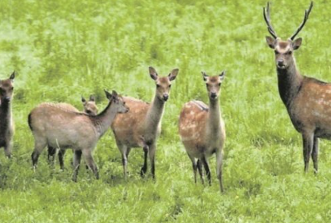
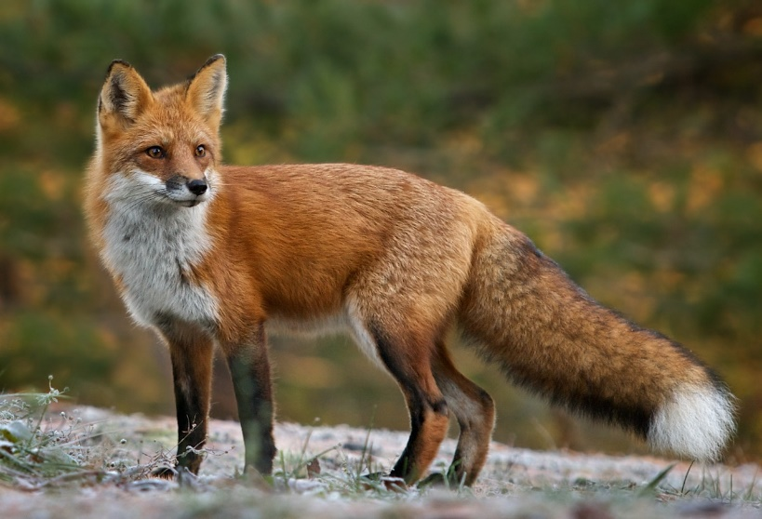
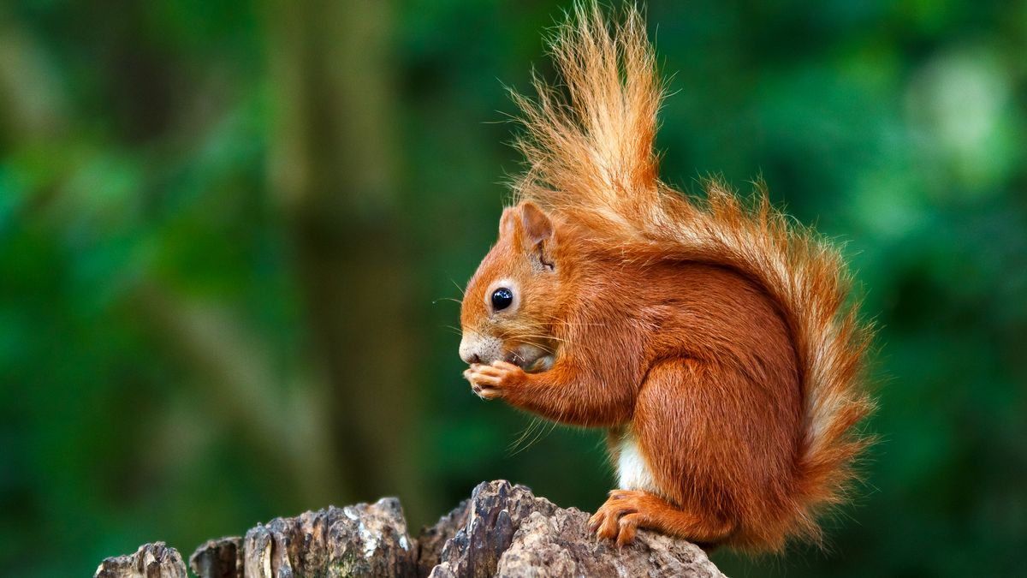
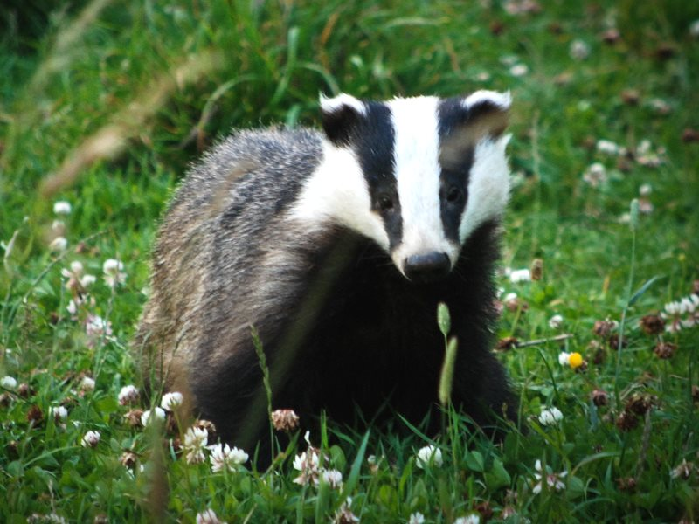
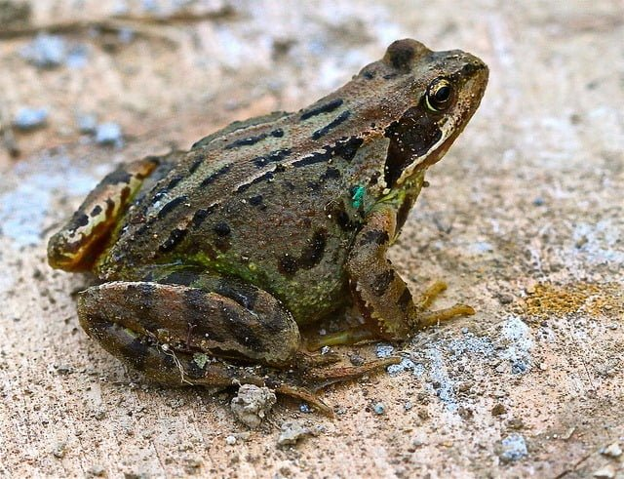
Red Fox
Red Deer
Red Squirrel
ANIMALS
Irish Badger
Common Frog

